Slide 1
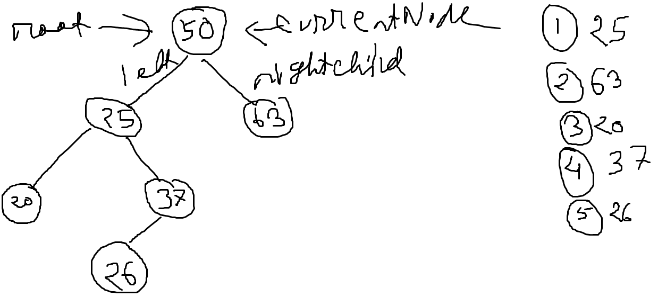
INSERT
Add 25:
currentNode = rootNode = 50
25 < 50 so
currentNode = currentNode.left
currentNode = None so
currentNode.leftChild = targetNode = 25 node
Add 63:
currentNode = rootNode = 50 node
63 > 50 so
currentNode = currentNode.rightChild
currentNode.value = None so
currentNode = targetNode = 63 node

Slide 2
INSERT
Add 20:
currentNode = rootNode = 50 node
20 < 50 so
currentNode = 50.leftChild = 25 node
20 < currentNode.value(25 node.value) so
currentNode = currentNode.leftChild = 25 node
currentNode.leftChild = None so
currentNode.leftChild = 20 Node
Add 37:
currentNode = rootNode = 50 node
37 < 50 so
currentNode = 50.leftChild = 25 node
37 > currentNode.value(25 node.value) so
currentNode = currentNode.rightChild = 25 node
currentNode.rightChild = 37 node
So, infinite loop hobe. Jodi value<cn.leftChild.value hoy, check korbo leftChild none kina. Hoile insert korbo. Noile cn = cn.leftChild, vice versa for rightchild

Slide 3
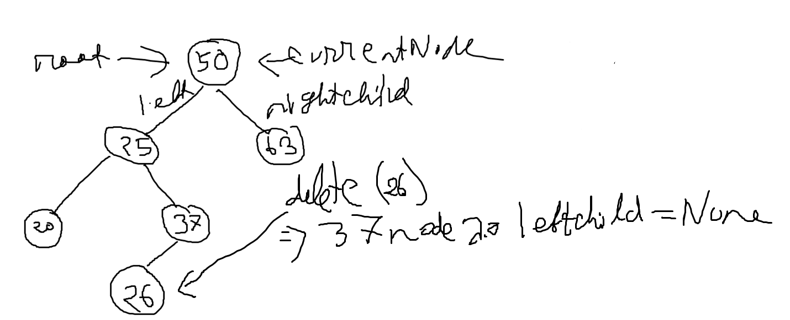
DELETE
Infinite loop. Jodi value < cn.val hoy, check if cn.leftChild is not none. If not, check if value == leftChild.value. If not, cn = cn.leftChild. Else, leftchild = none and true. Eivabe rightchild o.
currentNode = self = 50 node
26 < currentNode.value so
currentNode = cn.leftChild = 25 node
26 > cu.value so
currentNode = cn.rightChild = 37 node
37 node er leftChild.value == 26 so
Break
Jodi currentNode er leftChild.value == value hoy:
currentNode.leftChild = None
Else:
Cn.rightChild = None
Break er pore:
Jodi value < currentNode.value hoy:
currentNode.leftChild = none
Else:
cn.rightHCild = none

Slide 4
25 delete korbo. 25 er left tree te jodi kisu na thake, taile 25 er jaygay 25 er right tree boshay dibo, karon rootNode 50 er left tree te 50 er cheye boro kisui boshte parbe na, so ami eikhane 25 er jaygay 25 er right tree boshabo. vice versa.
Duitai thakle:
1. 25 er lefttree er maximum node ta ene 25 er jaygay boshaye dibo and maximumNode er leftCHild er hobe 25 er left tree, and rightChild hobe 25 er right tree.
Ekta node delete kora = parent er reference gula update kora
previousNode, nextNode

